Slide 1
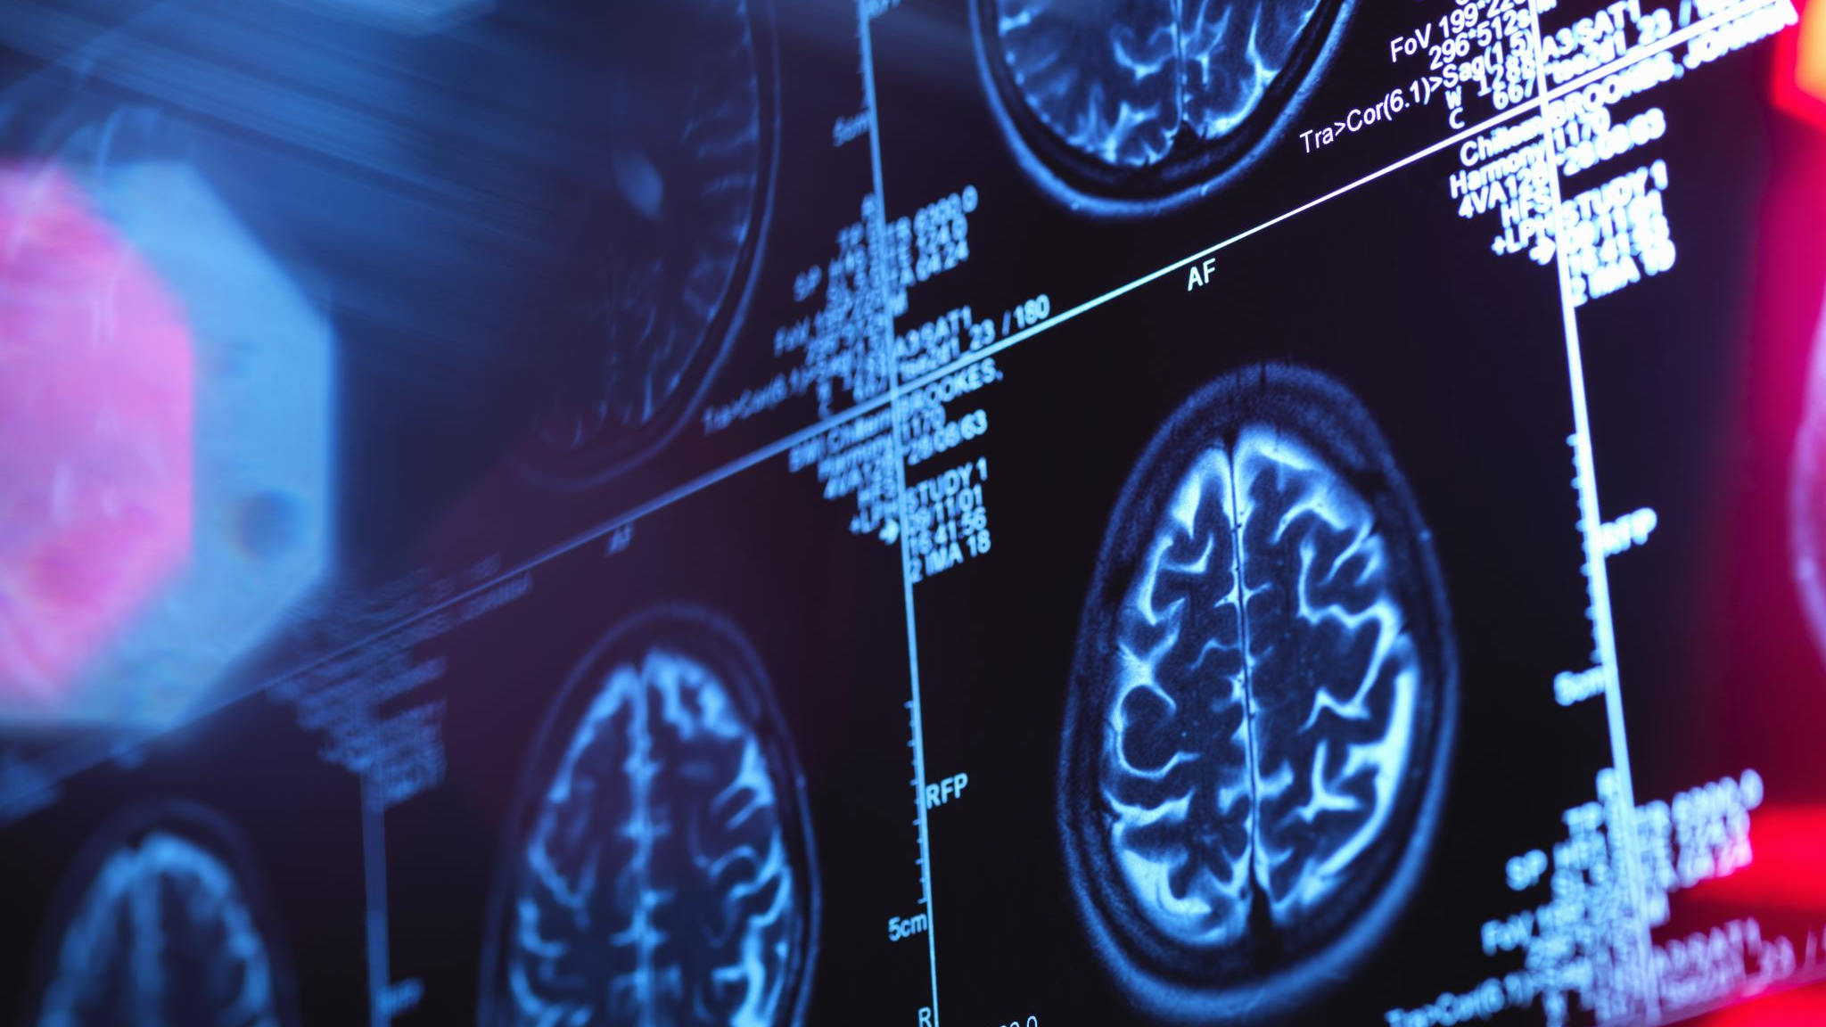
Acute Paediatric Neurology Case Studies
Dr Niamh Lynch and Professor Ronan O’Sullivan
Bon Secours Hospital, Cork

Slide 2
Case 1
‘Dear Dr Lynch, Patrick is a fourteen-year-old boy who sustained a head injury whilst playing a GAA match last weekend. He had dizziness, confusion and vomiting immediately afterwards. He was brought to the local emergency department, and was observed for several hours. He was discharged home with head injury advice. Since then he complains of an increasing headache, photophobia, and dizziness. Your urgent review would be much appreciated.’
Red flag: worsening headache. Likely diagnosis concussion. However, paediatric review warranted, and likely neuroimaging.
Next step: revert to GP, advise referral to PAU instead, and I can follow up in concussion clinic.

Slide 3
Paediatric Head Trauma

Slide 5
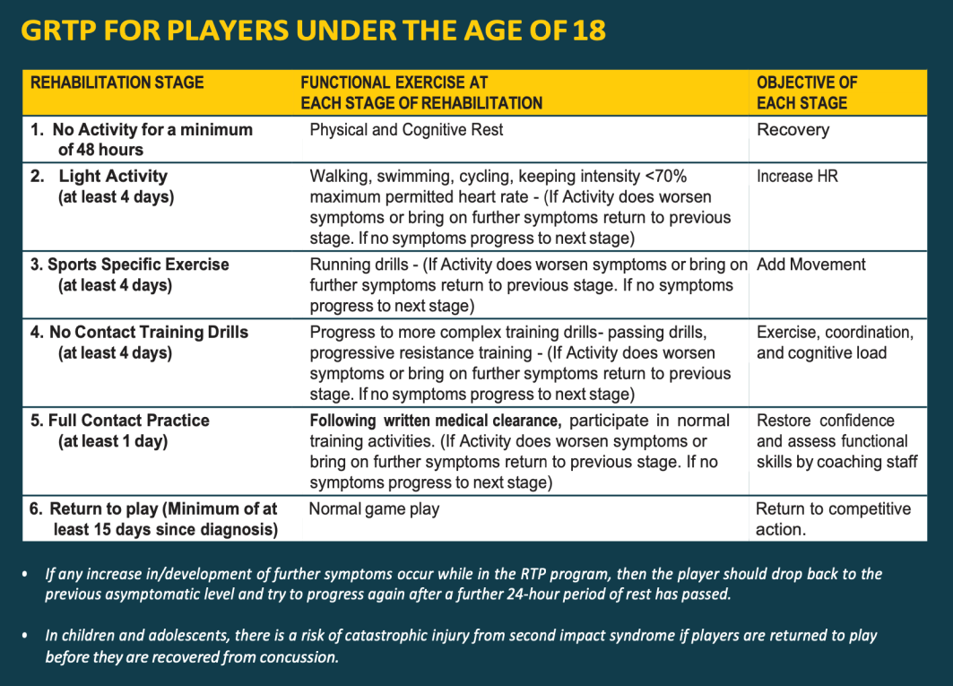
Case 1: PAU
MRI brain NAD
Diagnosis: Concussion
Parent Information Sheet (Concussion Physiotherapy)
GAA GRTP Protocol
Dr Lynch Concussion Clinic referral

Slide 6
Follow-up post PAU
Letter from PAU to me.
Diagnosis is concussion.
Attend my concussion clinic.
Further review and neurocognitive testing identify vestibular and migraine profile to concussion.
Referred to physiotherapy department for tailored rehabilitation exercises.

Slide 7
Case 2
‘Dear Dr Lynch, Emily is a five-year-old girl who has just started school. Her teacher noticed that she was having several ‘daydreaming spells’ in class, and informed her mother, who has now started noticing these episodes also. Please assess urgently to rule out childhood absence epilepsy.’
This child will need MRI with sedation, and EEG, and will need to be seen soon. My next available appointment is several weeks away.
Next step: revert to GP and advise referral to PAU.

Slide 8
Case 2: PAU
Clinical diagnosis absence seizures
IVC + baseline bloods
Respiratory viral panel (including COVID)
MRI brain (in a 5-year-old typically attempted without sedation)
EEG
ECG
Consider Echocardiography
Admission under Dr Lynch

Slide 9
Follow-up post PAU
Emily has had her investigations, and was admitted to the ward, where the diagnosis was explained to her parents, and she was commenced on ethosuximide.
On review in clinic, Emily’s parents say that they are noticing less episodes, but they are still present. A second outpatient EEG shows persistent absence events, with some atypical features.
Emily is admitted electively for 48-hour EEG telemetry, lumbar puncture and genetics. She is found to have a Glut 1 transporter deficiency and is commenced on the ketogenic diet, with good effect.

Slide 10
Case 3
‘Dear Dr Lynch, please see 11-year-old John urgently. He complains of debilitating headaches and has not gone to school for the past three weeks. His neurological examination is normal. His mother has migraine.’
Red flags: severe, worsening headache, school absence.
Next step: no appointments available for several weeks. This boy needs to be seen soon. Revert to GP, advise referral to PAU.

Slide 11

Case 3: PAU
MRI + MRA (arterial time-of-flight) NAD
Diagnosis: migraine
Rx: OTC/non-pharmacological analgesia for acute pain
Riboflavin (vitamin B2 – ‘Solgar’) 200-400mg OD x 3/12
Headache diary
Dr Lynch review @ 3/12

Slide 12
Follow-up post PAU
John diagnosed in migraine status in PAU and treated accordingly.
Clinic follow up - did well initially, but headaches have returned.
Commenced on topiramate as migraine prophylaxis with good effect.

Slide 13
PAU Neurology Casemix
Acute/subacute headache
Seizures – febrile or afebrile
Head injury – acute, subacute, concussion
Facial palsy
Neurocardiac – collapse query cause, POTS
Movement disorders – tics

Slide 14


Slide 15


