Slide 1
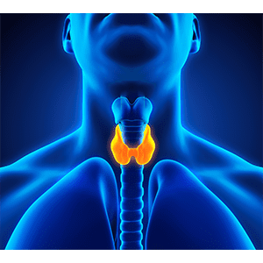
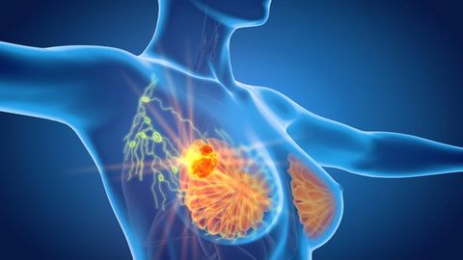
Advances in General Surgery
Mr Peter O’Leary
Consultant Breast, Endocrine and General Surgeon
8/9/20

Slide 2
My Background
Fellowship trained General Surgeon
Sub-specialty interest – Breast and Endocrine surgery

Slide 3
Practice overview
Elective and Acute General Surgery – Laparoscopic and Open procedures
Breast Cancer Surgery +/- Oncoplastics
2 triple assessment clinics week
Additional family history clinic
Endocrine Surgery – Thyroid and parathyroid surgery
Endoscopy – 2 lists/week, expanding to 3 lists
Minor ops – Moles/cysts/lipomas/IGTNs

Slide 4
Cases
Case 1 – Breast Cancer
Family History/Genetics
Oncoplastics
Case 2 – Thyroid nodule
‘Scarless’ thyroidectomy
Case 3 – Acute appendicitis
Surgery versus Antibiotics only

Slide 5
Case 1 – Breast Cancer
54 year old, female
New painless lump left breast x 2/52
Increasing in size
BreastCheck screening mammogram 2 years ago – Normal
Significant family history
1 sister out of 4 sisters, age at diagnosis – 42yo
Mother, age at diagnosis – 54yo

Slide 6
Triple assessment
1st step
Clinical (S4)
Clinically suspicious lump in left breast, 12 O’Clock position
Radiology (R5)
Radiological evidence of cancer
Mammogram with tomosynthesis reconstruction
Ultrasound breast and axilla
Biopsy (B5)
Invasive lobular cancer
Oestrogen receptor +
Progesterone receptor +
Her2 receptor –
2nd step
3rd step

Slide 7
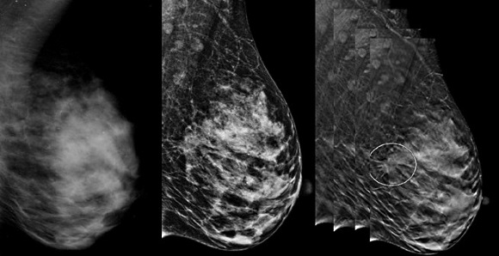
Mammogram + 3D Tomosynthesis Reconstruction
2mm slices through breast tissue
43% increase in breast cancer detection rate

Slide 8
Wide Local Excision

Slide 9
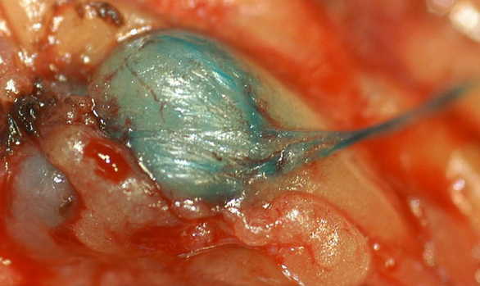
Sentinel Lymph Node Biopsy

Slide 10
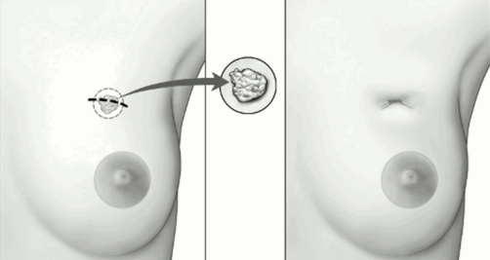
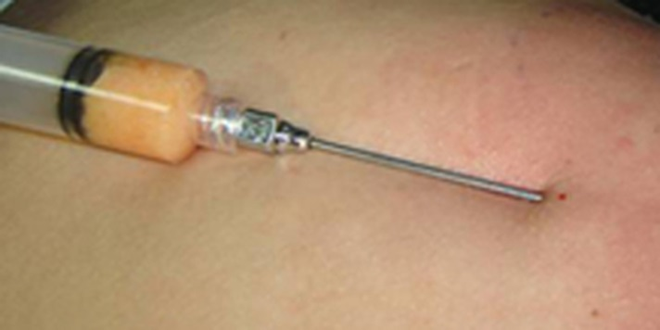
Oncoplastics – Fat grafting/Lipo-filling

Slide 11
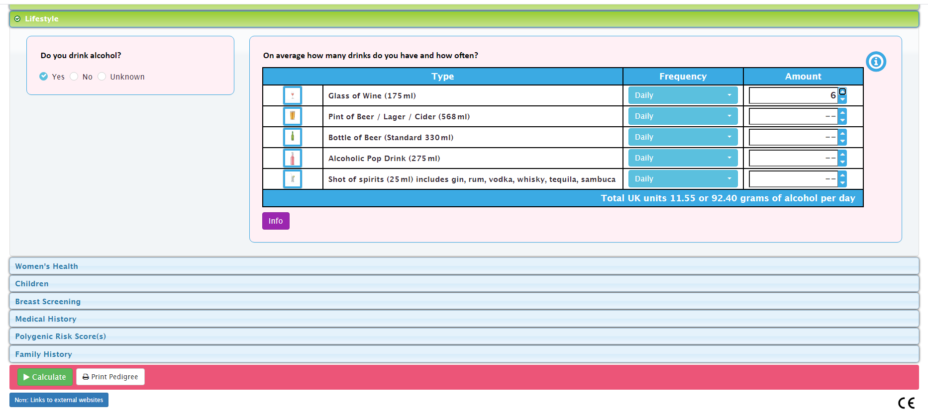
Family History

Slide 12
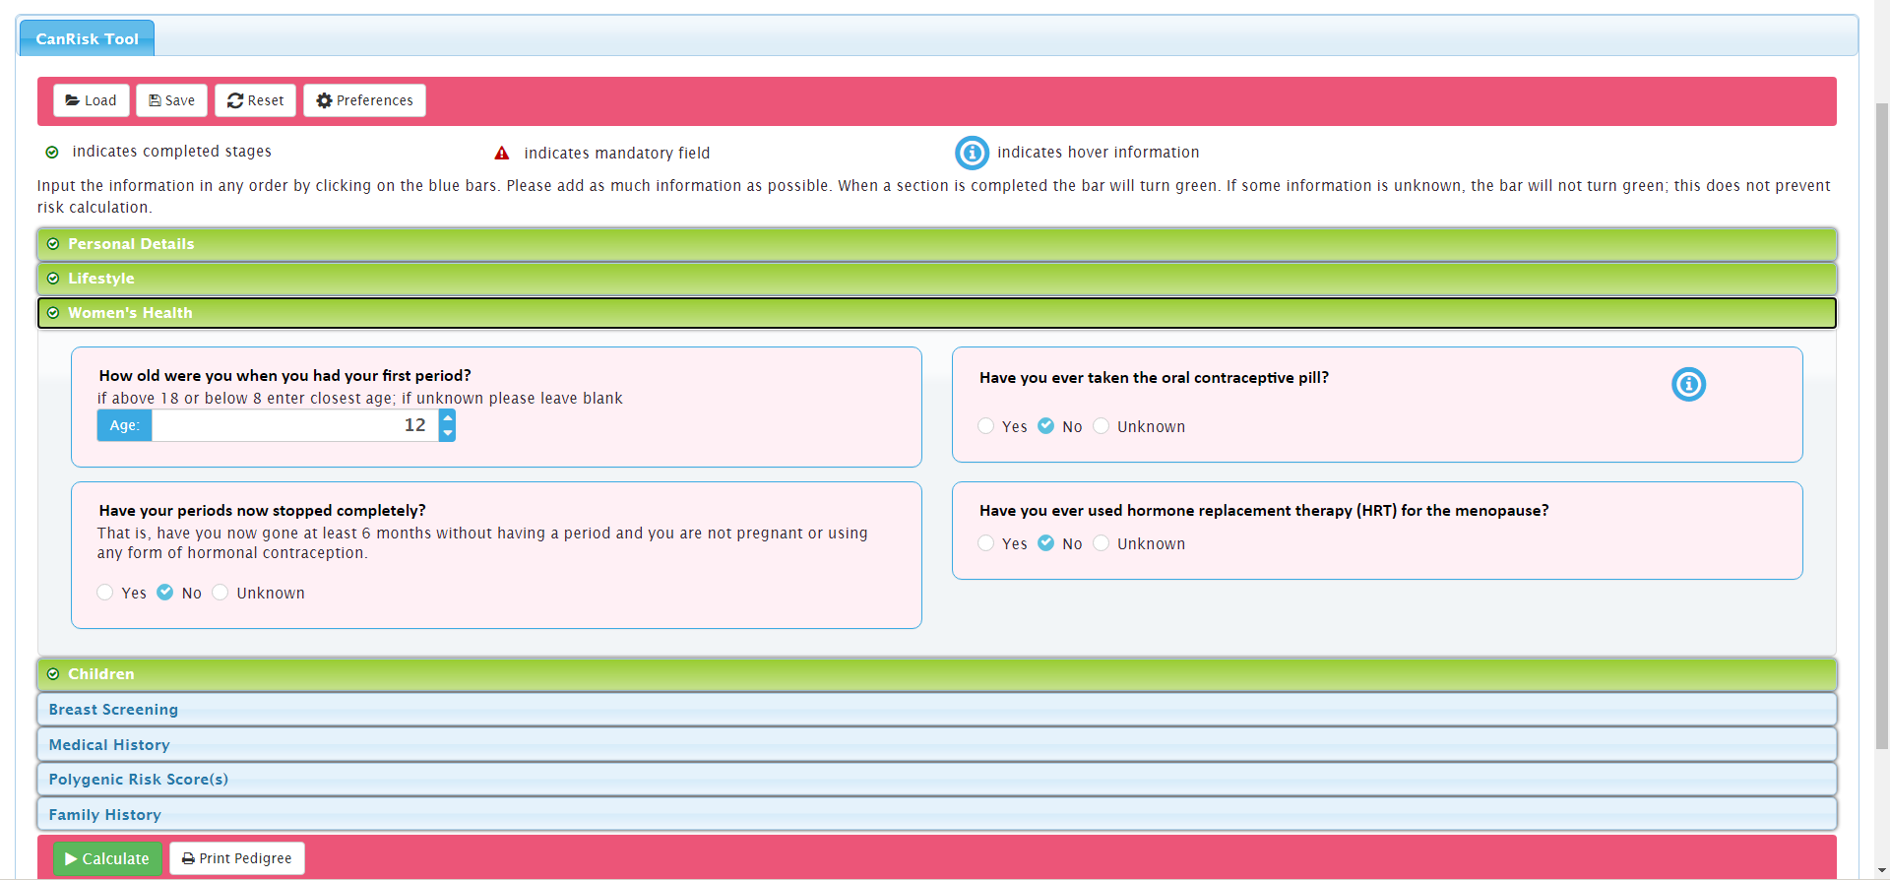

Slide 14
Case 2 – Thyroid nodule
42 year old, female
GP referral with new thyroid nodule x 6/52
Clinically/biochemically euthyroid
No dysphagia, dyspnoea or hoarseness

Slide 15
Triple assessment
Clinical exam – Discrete nodule palpable in right lower thyroid pole
US – 2.9cm right thyroid nodule with cystic and solid components
FNA – Atypical follicular epithelial cells
Thy3F

Slide 16
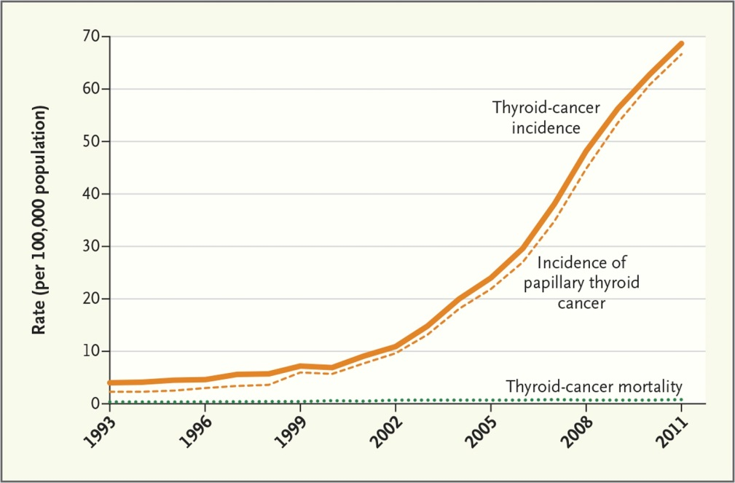

Slide 18
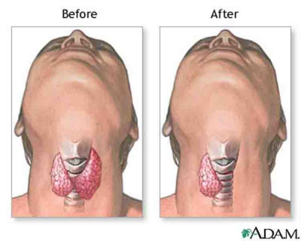
Treatment
Right thyroid lobectomy and isthmusectomy
Final histology – Follicular adenoma

Slide 19
New technique – ‘Scarless’ Thyroidectomy

Slide 20
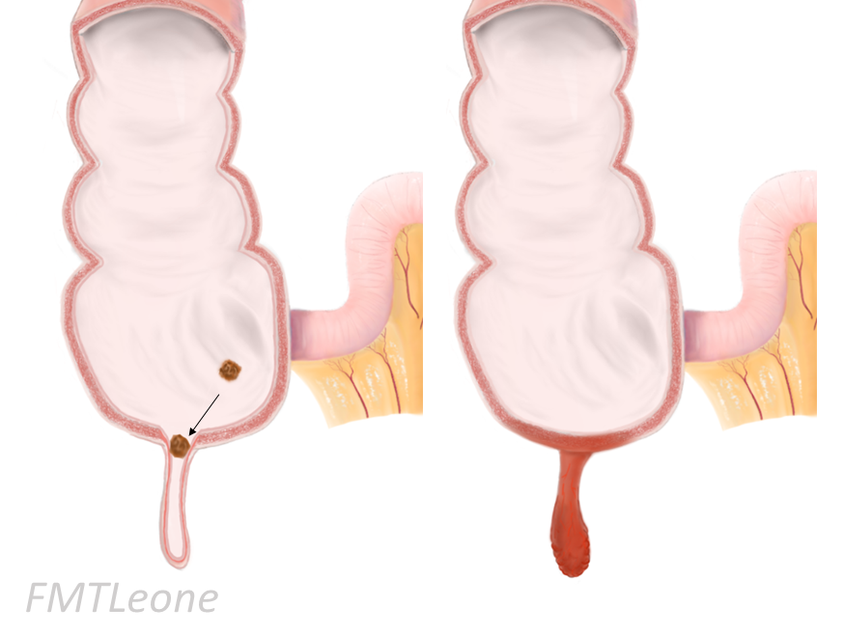
Case 3 – Acute appendicitis
32 year old, male
2 day history of peri-umbilical pain, now migrated to RIF
WCC normal, CRP = 32

Slide 22
Surgery v Antibiotics only??

Slide 23
COMMA Trial – In press, Annals of Surgery, 2020
Recurrence rates 7% - 39.1%
Lacking quality of life data

Slide 24
Methods
Randomised control trial
Single centre, open label
Inclusion criteria
Male/female patients
Aged >16
RIF pain
Raised WCC and/or CRP
Radiology protocol
<45 yo
US +/- MRI scan
>45 yo
CT scan

Slide 25
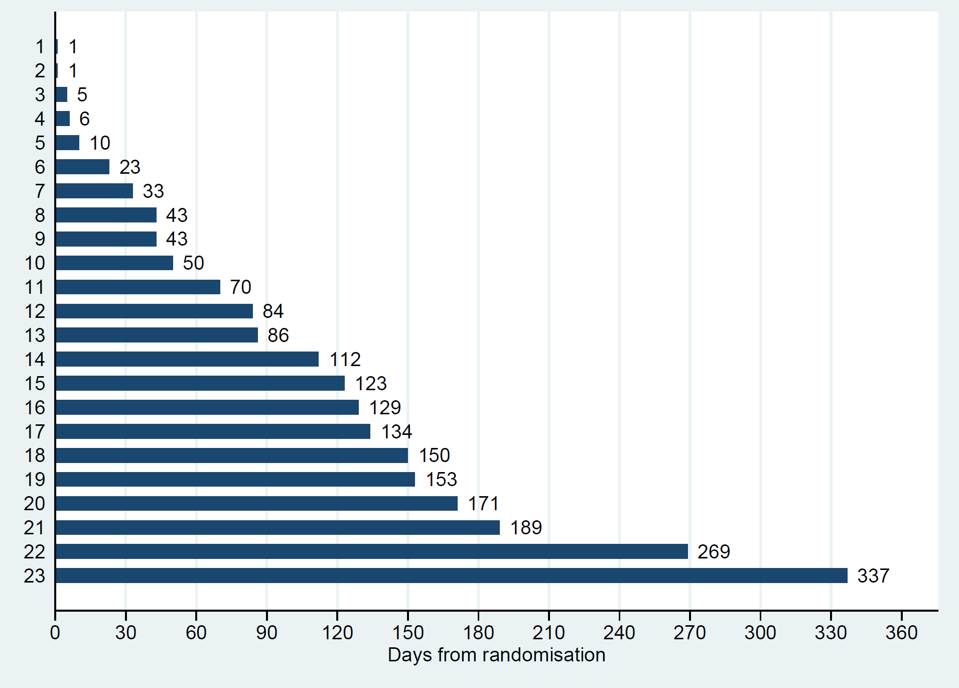
Results
25.3% recurrence rate at 1 year follow-up
26.1% of recurrences occurred within one month of intervention
31.9% recurrence at median follow-up of 28.8 months
Recurrence timeline within 1 year

Slide 26
Results
Quality of life at 1 year
EQ-5D-3L index score
1.0 v 0.88, p<0.001
EQ-visual analogue scale
94.5 v 90.4, p<0.01
Proportion of patients in full health
0.876 v 0.439, p<0.01
p<0.001

Slide 27
Take home messages…
Increasing number of oncoplastic options for breast cancer patients, even those undergoing breast conservation/lumpectomy
Genetics is an increasingly important aspect of breast cancer care due to better understanding and improved technology
‘Scarless’ thyroidectomy options available for patients highly motivated to avoid traditional scar
Surgery remains mainstay for treatment of acute appendicitis

Slide 28
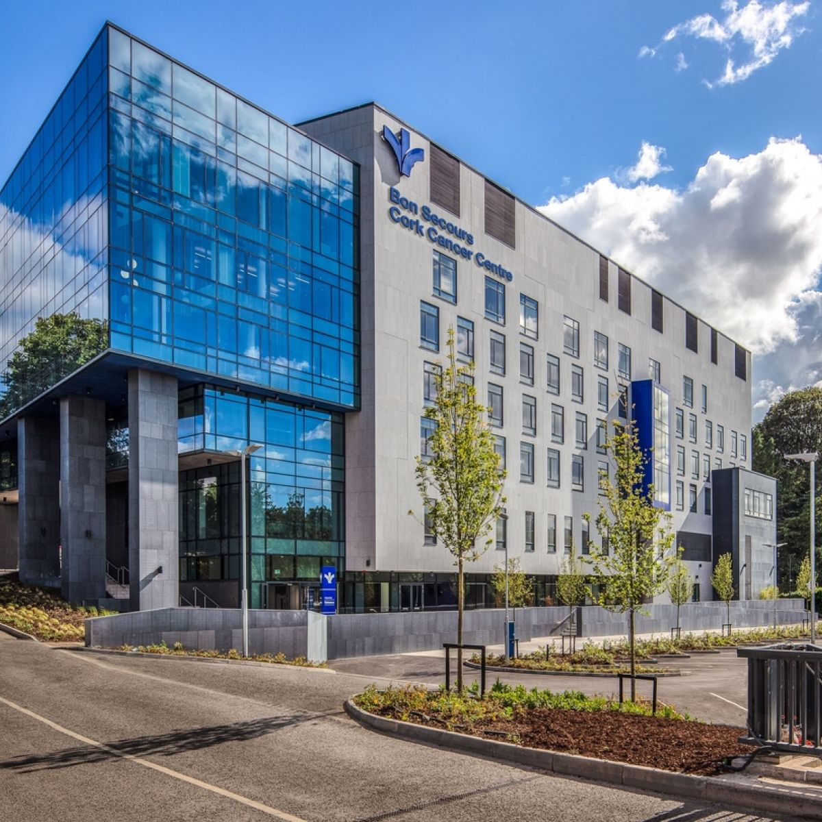
Questions??

Slide 29
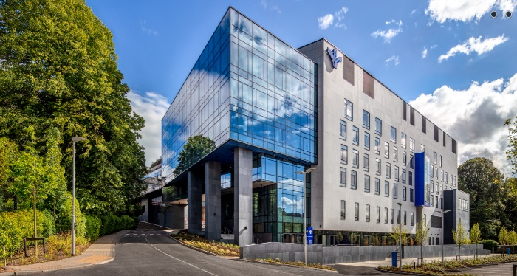
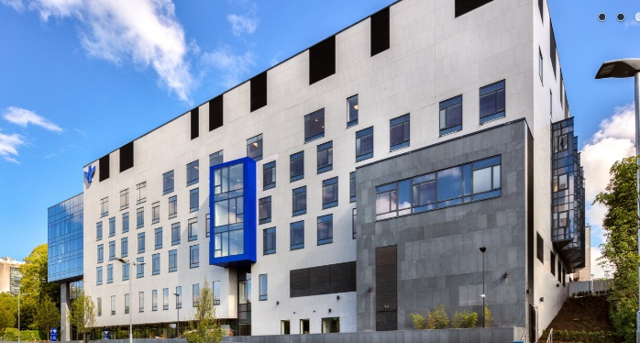
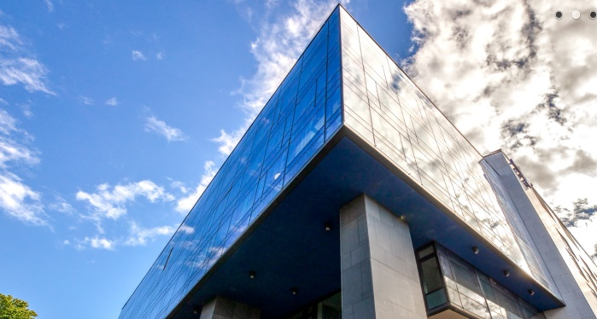
Prostate cancer diagnosis and treatment in 2020
Paul Kelly
Radiation Oncologist
Bon Secours Radiotherapy Cork
In partnership with UPMC Hillman Cancer Centre

Slide 30
Topics
Who to screen?
Who to refer?
Diagnostic pathway in 2020
MDT
Options discussion

Slide 31
ERSPC European Screening Trial
NEJM 11 year follow-up
Notes:
ERSPC screening every 4 years, PSA cutoff of 3.0

Slide 32
ERSPC European Screening Trial
NEJM 11 year follow-up
European Urology 16 year follow-up
Notes:
ERSPC screening every 4 years, PSA cutoff of 3.0

Slide 33
ERSPC European Screening Trial
NEJM 11 year follow-up
European Urology 16 year follow-up
21% relative reduction in prostate cancer mortality
At 11 years, NNI=979, NND=35 to prevent 1 death from prostate cancer
Notes:
ERSPC screening every 4 years, PSA cutoff of 3.0

Slide 34
ERSPC European Screening Trial
NEJM 11 year follow-up
European Urology 16 year follow-up
21% relative reduction in prostate cancer mortality
At 11 years, NNI=979, NND=35 to prevent 1 death from prostate cancer
? Clinically relevant
Notes:
ERSPC screening every 4 years, PSA cutoff of 3.0

Slide 35
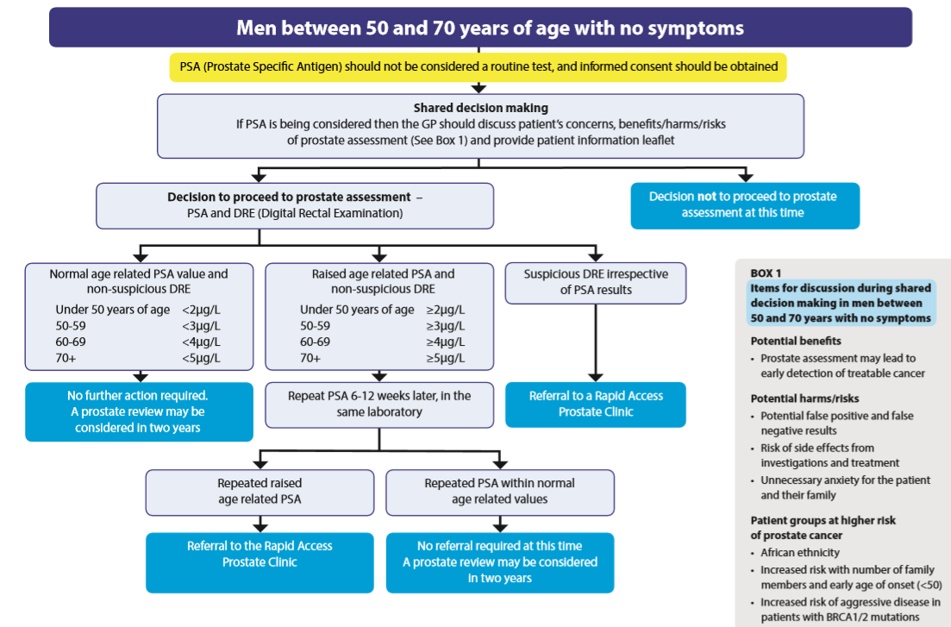

Slide 38
What about men outside of 50-70 year age range?
<50 years:
if PSA >2.0 or abnormal DRE
Family history, especially with early age at diagnosis
Notes:
<50 will be seen in Rapid Access
>70 general urology referrals only

Slide 39
What about men outside of 50-70 year age range?
<50 years:
if PSA >2.0 or abnormal DRE
Family history, especially with early age at diagnosis
>70 years:
If re-checked PSA >5.0 or abnormal DRE
Life expectancy ≥ 10 years
Notes:
<50 will be seen in Rapid Access
>70 general urology referrals only

Slide 40
Diagnostic pathway has changed
Referral Urology/
Radiation Oncology
Pre-biopsy MRI
Biopsy: TRUS or Transperineal
Diagnosis is multidisciplinary:
Urology
Radiology
Radiation Oncology
Pathology
Pre-biopsy MRI now standard
Biopsy options have changed
MDT discussion

Slide 41
NICE guidance 2019: offer pre-biopsy MRI to all

Slide 42
Should I order a prostate MRI in GP?
No role for prostate MRI in absence of elevated PSA/abnormal DRE
Important issue regarding Prostate MRI
Specialist centre using correct protocols
Multiparametric sequences
Reported by radiologists experienced in prostate MR

Slide 43
Advantages to MRI
Proven to reduce the number of unnecessary biopsies
Fewer missed clinically significant cancers i.e. ≥Gleason 7
PROMIS trial Ahmed et al. Lancet 2017
PRECISION trial Kasi et al. NEJM 2018

Slide 44
PI-RADS score determines the likelihood of clinically significant prostate cancer

Slide 45
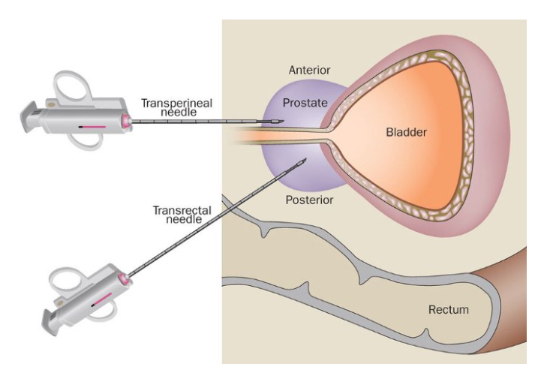
Biopsy has changed
Systematic
Targeted
? TRUS or Transperineal

Slide 46
Hazards of Prostate TRUS Biopsy
You may miss!

Slide 47
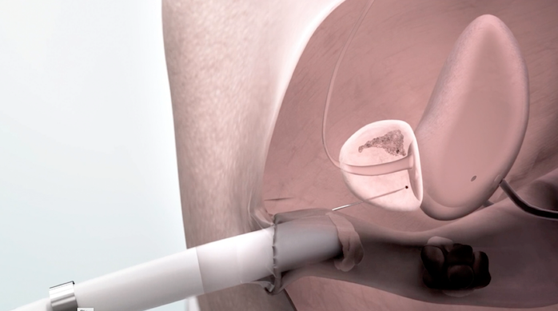
Hazards of Prostate TRUS Biopsy
2. Infection (5-7%) Sepsis (3% hospitalised)

Slide 48
Hazards of Prostate TRUS Biopsy
3. Not patient-friendly!

Slide 49
Transperineal Biopsy
The patient’s perspective:
Safe
Accurate
Relatively pain-free
Knock me out Doctor!
[GA 15-20 minutes]
Can be performed under local anaesthetic also

Slide 50
Prostate MDT
Members:
Radiologist
Pathologist
Urologists
Radiation Oncologist
Medical Oncologist
MDT coordinator
Purpose:
Critically examine diagnostic tests
Ensure optimal standards of care applied to each case
Peer review of treatment options
Group expertise in complex cases

Slide 51
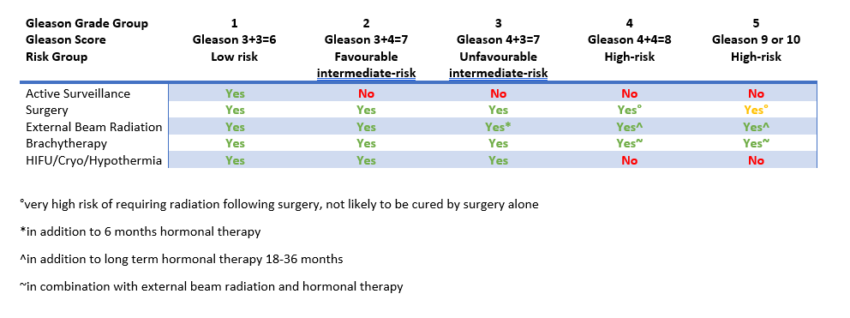
Prostate cancer treatment options

Slide 52
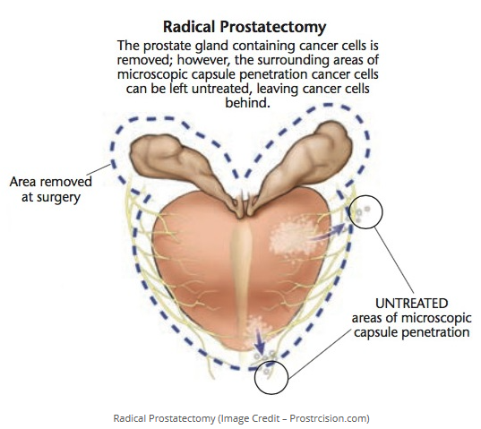
Prostate cancer surgery in Ireland
OPEN
Radical Retropubic Prostatectomy
ROBOTIC
Robotic-Assisted Radical Prostatectomy
Locations:
Bons
CUH
MUH
Locations:
CUH
Mater Private Dublin
The Galway Clinic
Beacon Hospital
SVPH

Slide 53
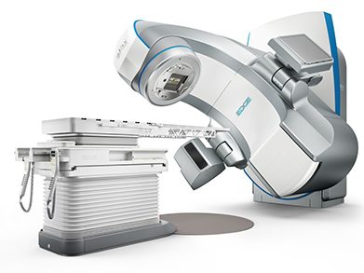
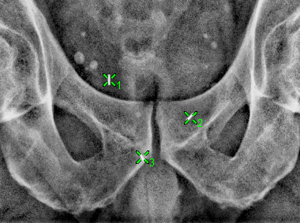
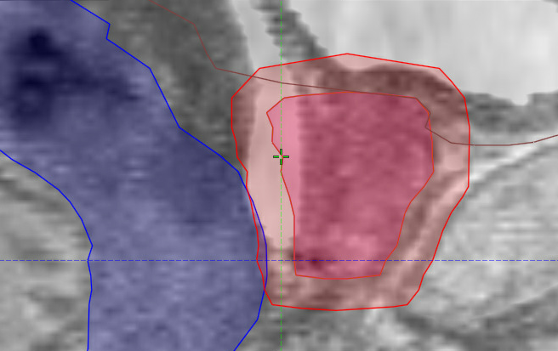
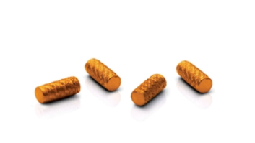
Prostate Radiation in 2020
Fiducial Markers
Rectum
Prostate
Gel Spacer

Slide 54
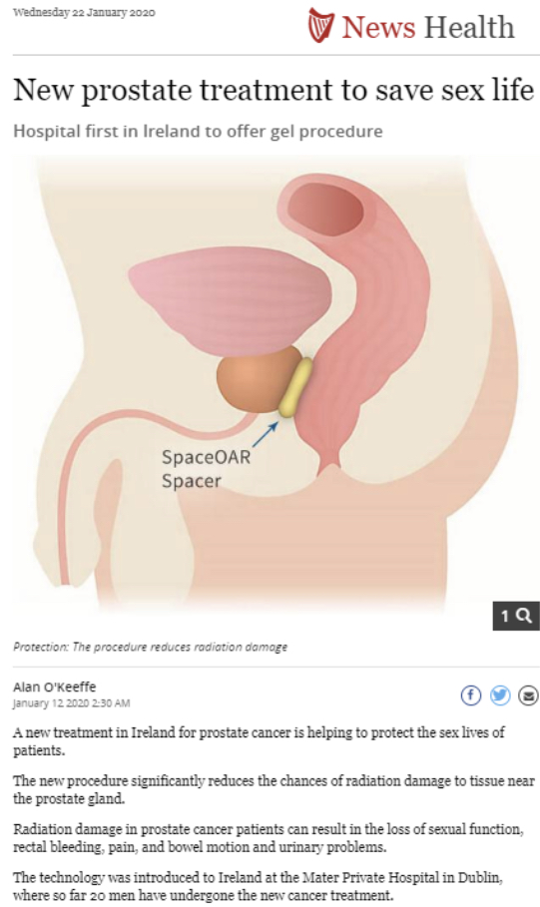
Sunday Independent 12th Jan 2020

Slide 55
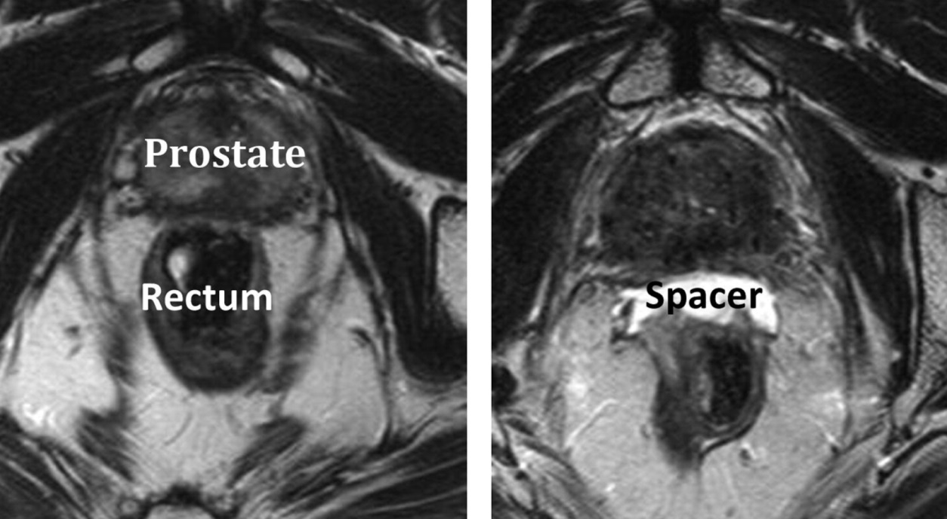
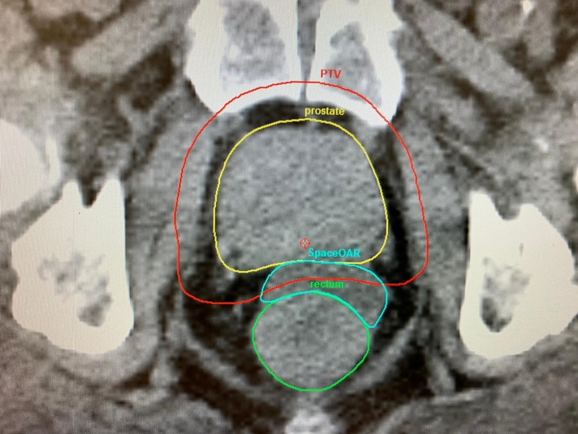
Gel spacer case

Slide 56
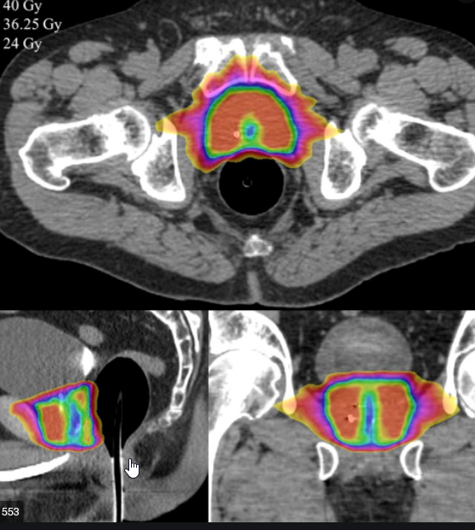
Stereotactic Radiation
Duration of external radiation reduced to 5 sessions
Alternate weekdays
Treatment sessions lasting approximately 10 minutes

Slide 57
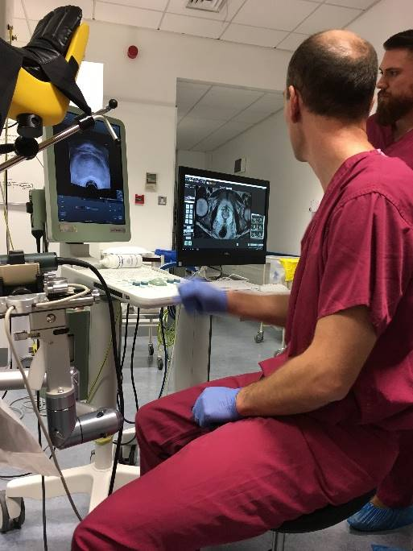
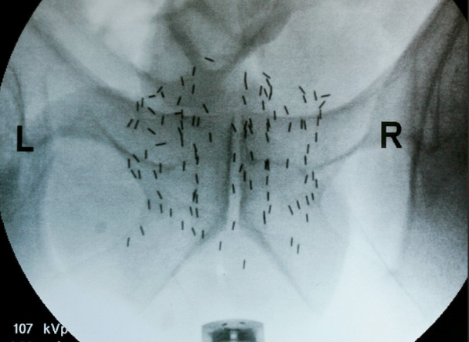
Brachytherapy

Slide 58
Who can have brachytherapy?
Monotherapy
G3+3=6
G3+4=7
Prostate volume <50cc
Minimal LUTS
Combination therapy
High-risk
Gleason 8-10
hormonal therapy and external radiation

Slide 59
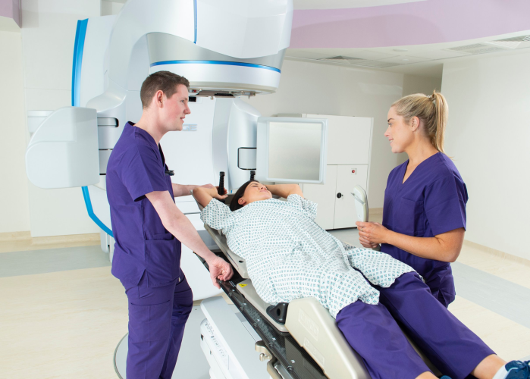
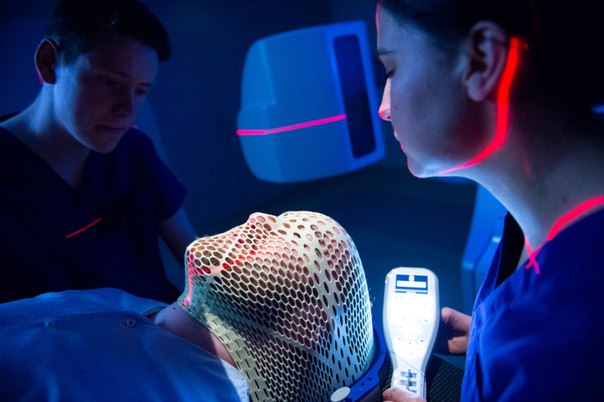
APPOINTMENT CONTACT DETAILS:
Radiotherapy Department Bon Secours Hospital Cork
College Road
Cork
021-4861100
REFERRALS AND ENQUIRIES
EMAIL: kellyp6@upmc.ie
Enquiries: Info-hccbs@upmc.edu
Referrals: referrals@bonsecours.ie/Healthlink

