Slide 1
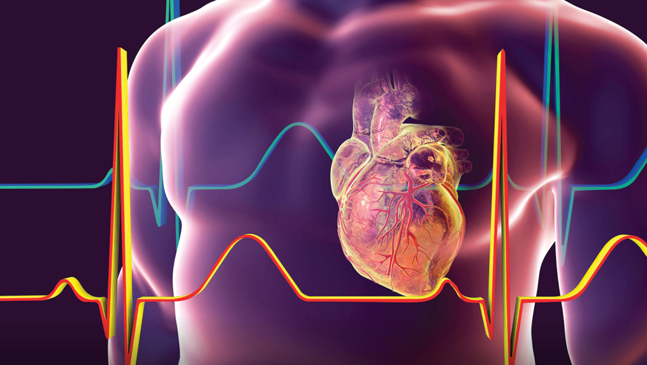
Cardiology Pathway
Bon Secours Hospital, Cork.
Dr Cróchán O’Sullivan MD, PHD, FESC

Slide 2
Cardiology service
Non-invasive cardiology
Cardiovascular imaging
Interventional cardiology
Electrophysiology

Slide 3
Non-invasive cardiology
Exercise stress testing
Holter monitor
24-hour blood pressure monitor
Event recorders
Dobutamine stress echo.

Slide 4
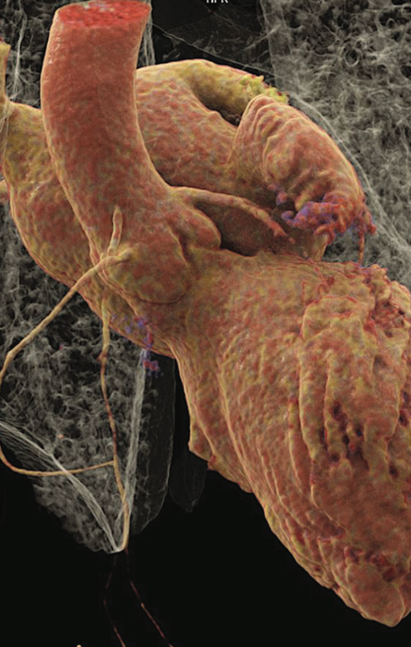
Advanced Cardiovascular Imaging
Transthoracic echo
Transoesophageal echo
Coronary CT calcium score
CT coronary angiography
Structural Cardiac CT
Cardiac MRI
  Perfusion MRI
  Structural MRI

Slide 5
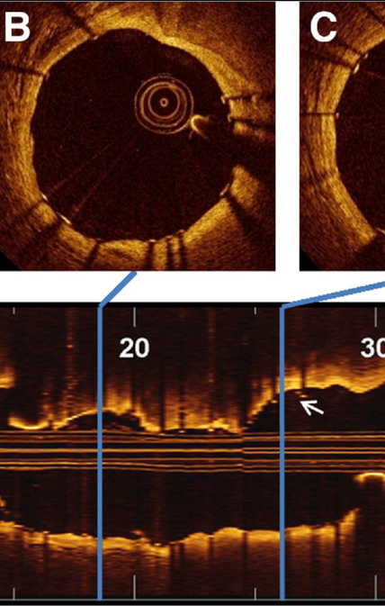
Interventional cardiology
Percutanous coronary intervention
  Fractional flow reserve (FFR)
  Instantaneous free-wave ratio (iFR)
  Intravascular lithotripsy
  RotaPro
Intracoronary imaging
  Optical coherence tomography
  Intravascular ultrasound
PFO/ASD closure
Left atrial appendage occlusion
Transcatheter aortic valve implantation

Slide 6
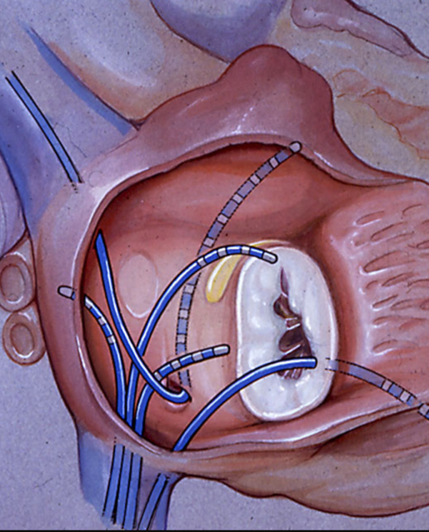
Electrophysiology
Electrophysiological studies.
Ablation of accessory pathways.
Pulmonary vein isolation.
Atrial flutter ablation.
Loop recorder implantation.
Permanent pacemaker implantation.
Intracardiac defibrillator implantation.
Biventricular pacemaker implantation.

Slide 7
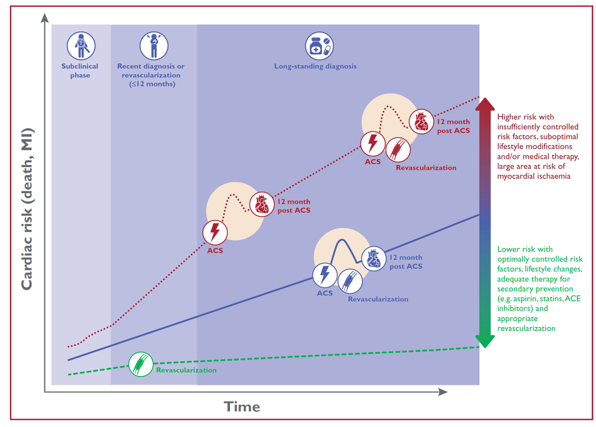
Natural History of chronic coronary syndromes

Slide 8
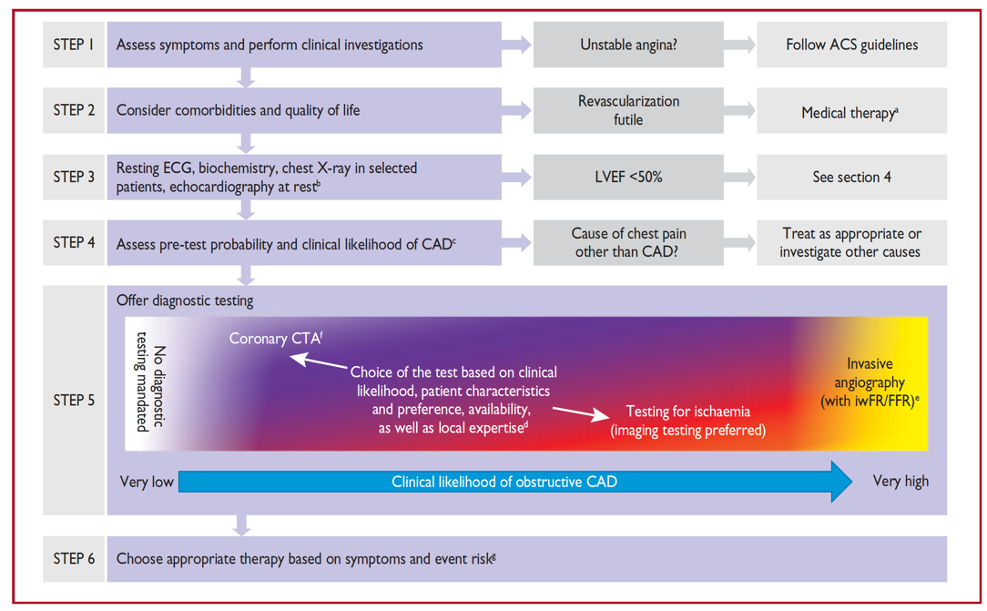
Initial diagnostic approach for patients with suspected angina

Slide 9
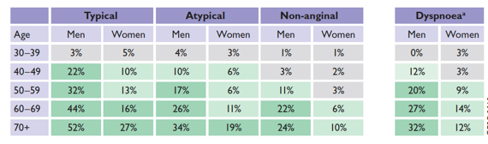
Pretest probability of Obstructive Coronary artery disease
Based on a pooled analysis of contemporary data of 15,815 symptomatic patients according to age, sex and the nature of symptoms.

Slide 10
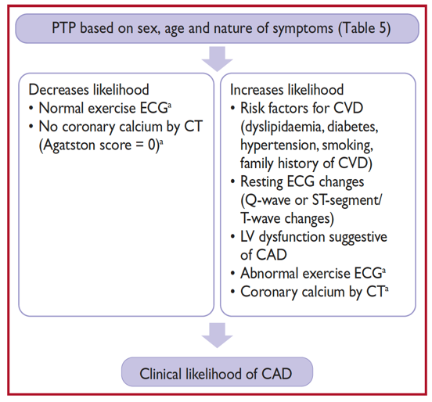
Determinants of the clinical likelihood of obstructive coronary artery disease

Slide 11
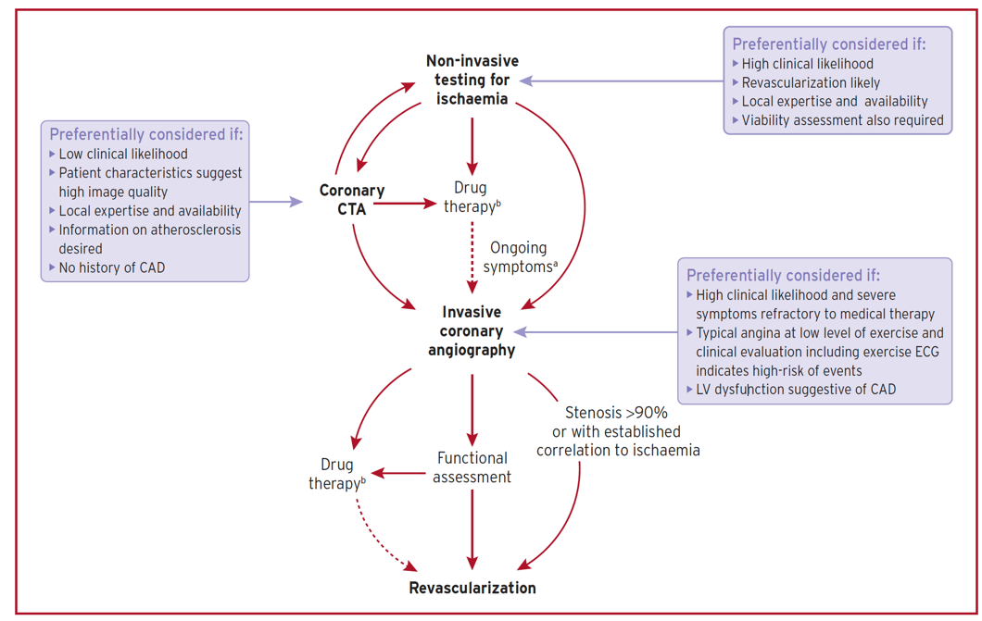
Main diagnostic pathways in symptomatic patients with suspected obstructive coronary artery disease

Slide 12
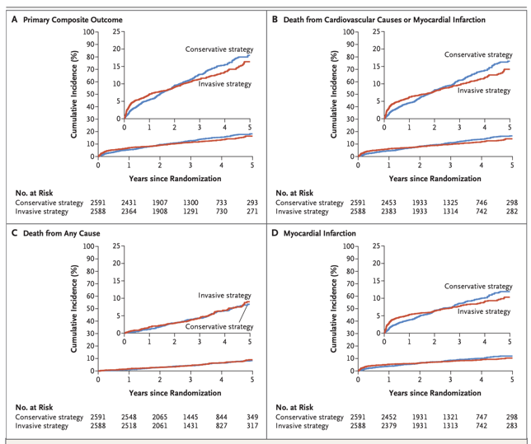
Ischemia trial nejm 2020
N Engl J Med 2020;382:1395-407
5,179 patients with moderate to severe ischemia randomized to an initial invasive strategy versus an initial conservative strategy of medical therapy alone and angiography if medical therapy failed.
Primary endpoint: composite of cv death, MI, hospitalization for unstable angina, heart failure or resuscitated cardiac arrest.

Slide 13
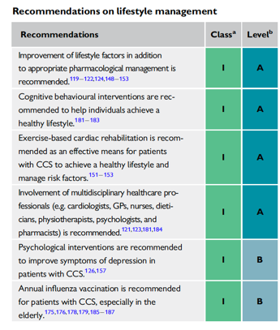
Lifestyle management of chronic coronary syndromes

Slide 14
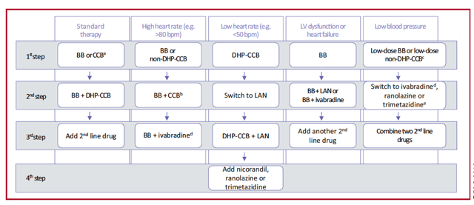
Medical therapy of chronic coronary syndromes

Slide 15
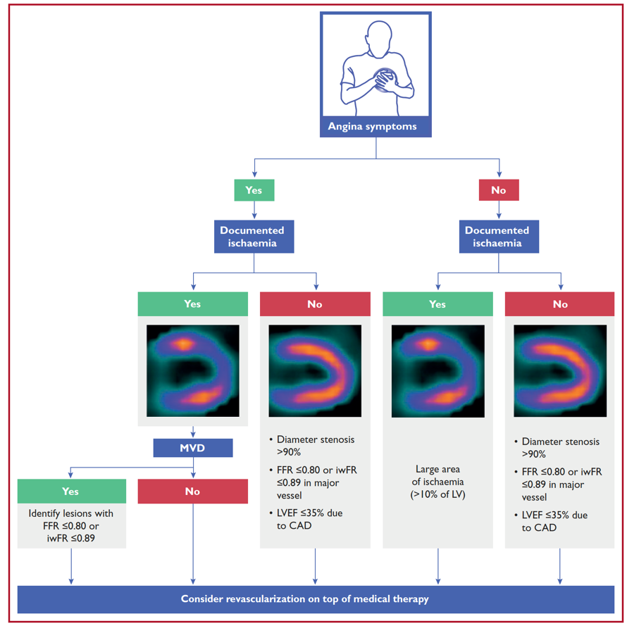
Decision Tree for patients undergoing invasive coronary angiography

Slide 16
Acute Coronary Syndrome^{1,2}
0 h/1 h hs-Troponin I-Algorithm
Acute Chest Pain
Ischaemic ECG changes and persistent chest pain
STEMI-Protocol
ST-Elevation
ECG
Invasive management
hs-Troponin I
On admission and after 1 hour.
<2 ng/L
<5 ng/L
and rise in
1 hr. <2 ng/L
2-5 ng/L
and rise in
1 hr. 2-5 ng/L
5-51 ng/L
and rise in
1 hr. <6 ng/L
≥52 ng/L
Rise in
1 hr. ≥6 ng/L
Heart attack ruled out
Observe
Heart attack probable
Another test 3 hours after admission
Pain free, Differential diagnoses ruled out
No
Rise ≥10 ng/L
Yes
Discharge/Stresstest
Invasive investigation
1. Roffi M et al. ESC Non-STEMI Guidelines Eur Heart J 2015; 2. Reichlin T et al. CMAJ 2015;187(8):E243-E252

Slide 17

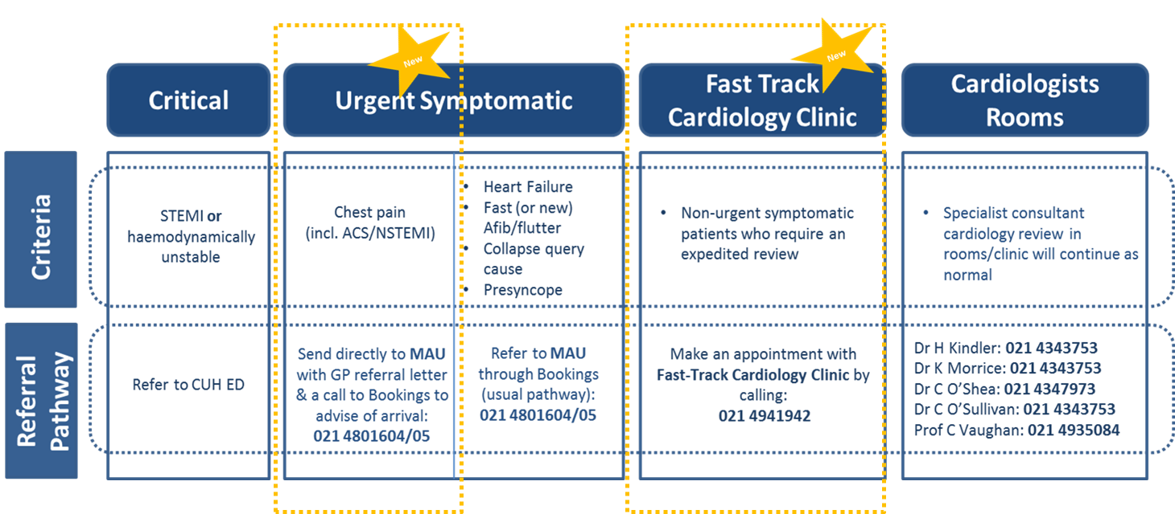
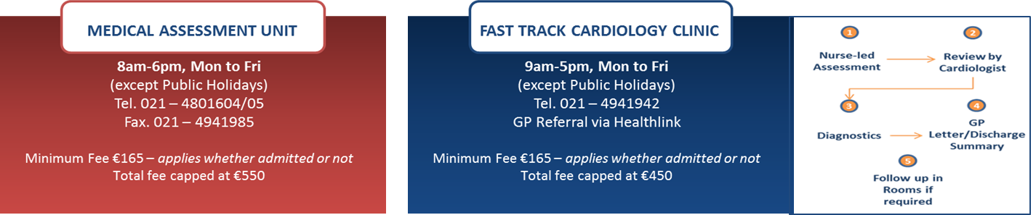
Cardiology Referral Pathways
30/06/20

Slide 18
Acute Cardiology in the MAU
Prof. Ronan O’Sullivan
Consultant in Emergency Medicine
Bon Secours Hospital, Cork

Slide 19


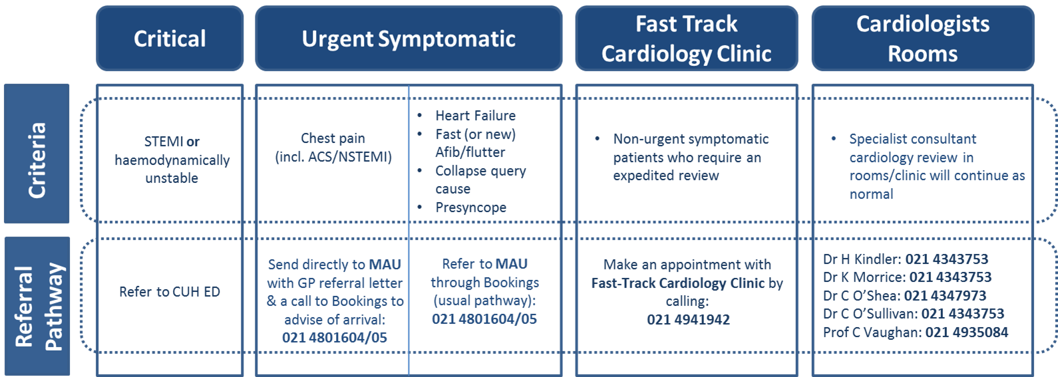
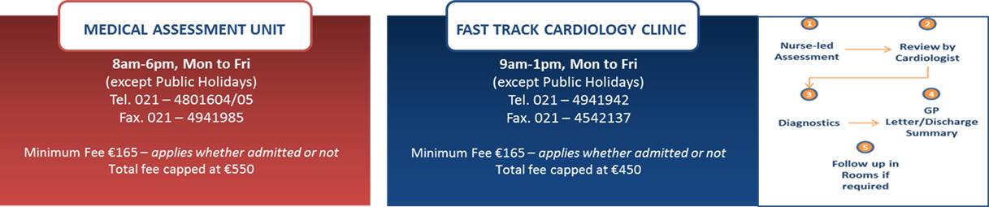
Cardiology Referral Pathways

Slide 20
Chest Pain
Chest pain is high-frequency, high-risk chief complaint
ACS (STEMI/NSTEMI/UA) v ‘low-risk chest pain’
  Which is more challenging?

Slide 21
Clinical History
No one element sufficiently sensitive
Typical v less typical
  1 in 20 diagnosed w/ acute MI will present atypically
Clinician gestalt very sensitive

Slide 22
ECG
ACEP: Door-to-ECG time 10 mins
  Even among patients who ultimately rule in for MI, an initial ‘diagnostic’ ECG more exception than rule
ACEP: patients w/ suspected ACS, ECG should be repeated at interval of 30 and 60 mins

Slide 23
Biomarkers
Essential element of acute assessment
Timing of symptoms relative to biomarker measurement
  Hours/days/constant – single test possible
  Intermittent – biomarker stopwatch reset?
Not all +ve troponins represent ACS (CHF, renal failure, sepsis)

Slide 24
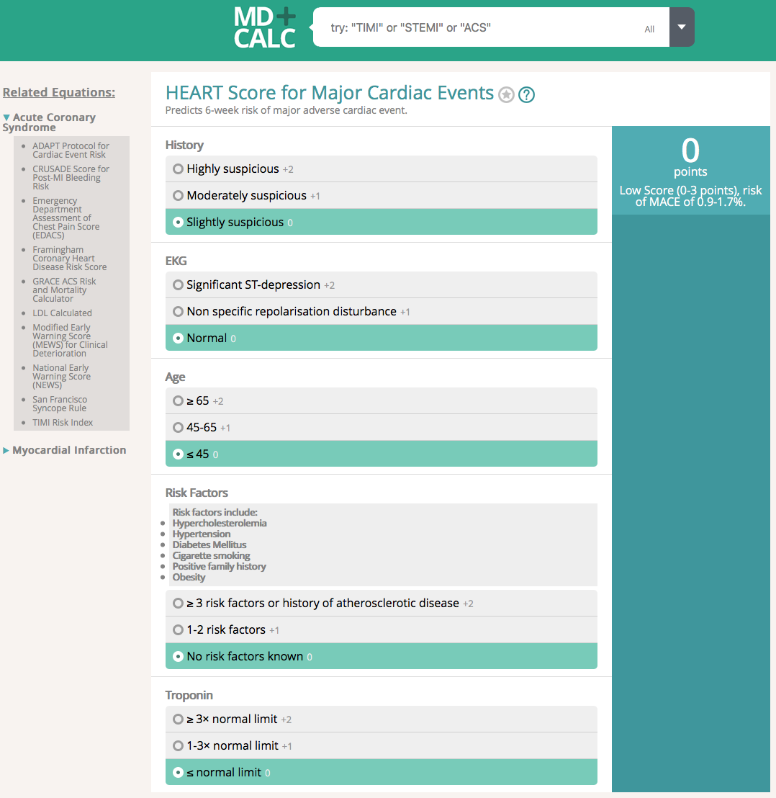

Slide 25
Additional Testing
EST relatively low yield
Is stress testing still ‘standard of care’?
Helpful in patients w/ higher pretest probability of CAD
CT Coronary Calcium Screen/Score
Coronary CT Angiography
Cardiac Perfusion MRI
Echocardiography
Non-Cardiac
CTPA
Abdominal imaging (USS/CT)
Spinal imaging (MRI)

Slide 26
Other Causes of Chest Pain
Respiratory
VTE
Infection
GI
MSK (incl. spinal)
Skin
Anxiety/Stress

Slide 27
Cardiology Referral Pathways

Slide 28
Other Acute Cardiology
Acute/subacute Heart Failure (cave COVID)
Palpitations
AF/flutter
Collapse query cause
Suspected TIA
Presyncope
    Echo, Holter/Telemetry, MRI Brain, Carotid USS, CTPA/CXR, bloods, Cardiology review, +/- Neurology review

Slide 29
Experience to Date
Increase in chest pain referrals
  Anxiety-related symptoms (chest pain, dysfunctional breathing)
  CAD, VTE amongst these…
FTCC referrals redirected to MAU
  Collapse query cause
  Suspected TIA
  TGA (transient global amnesia)
  Myositis with chest pain

Slide 30


