Slide 1
Anaphylaxis

Slide 2
COVID-19 Vaccinatation Side Effects

Slide 3
COVID-19 Vaccinatation Side Effects

Slide 4
Vaccine Adverse Event Reporting System
December 14–23, 2020,
1,893,360 first doses of the Pfizer-BioNTech COVID-19 vaccine
21 cases of anaphylaxis
(11.1 cases per million doses);
71% of these occurred within 15 minutes of vaccination.
Implications
screening recipients for contraindications and precautions,
manage anaphylaxis,
postvaccination observation periods
immediately treating suspected cases of anaphylaxis with intramuscular injection of epinephrine.

Slide 5
European Academy of Allergy and Clinical Immunology (EAACI)
The benefit of the vaccination clearly outweighs the risk of severe COVID-19 development including the more than 30% of the population suffering from allergic diseases.
Klimek L, Jutel M, Akdis CA, Bousquet J, Akdis M, Torres-Jaen M, Agache I, Canonica GW, Del Giacco S, O'Mahony L, Shamji MH, Pawankar R, Untersmayr E, Ring J, Bedbrook A, Worm M, Zuberbier T. ARIA-EAACI statement on severe allergic reactions to COVID-19 vaccines - an EAACI-ARIA position paper. Allergy. 2020 Dec 30. doi: 10.1111/all.14726. Epub ahead of print. PMID: 33378789.

Slide 6
“So.... is it anaphylaxis?,
Maybe it’s just a reaction?!,
Maybe it’s just an allergy?
Will I wait and see....?”

Slide 7
UpToDate

Slide 8
UpToDate

Slide 12
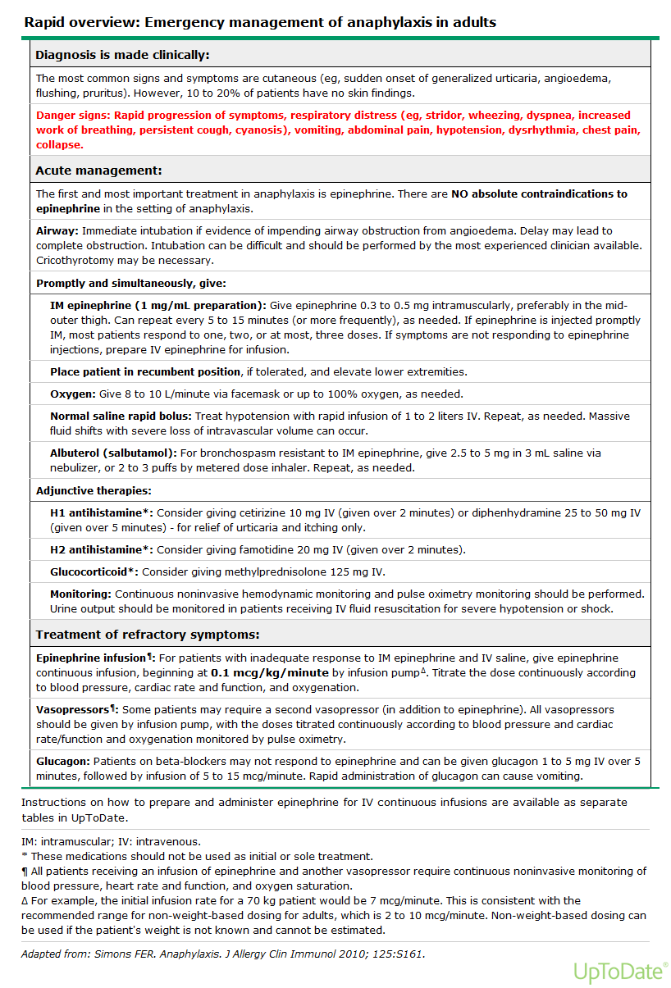

Slide 13
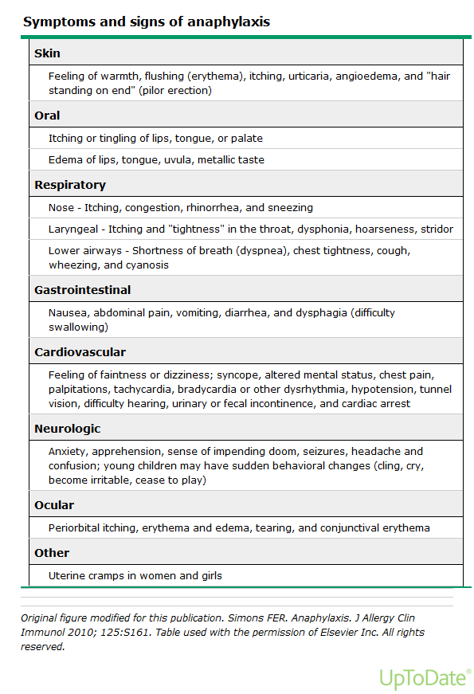

Slide 14
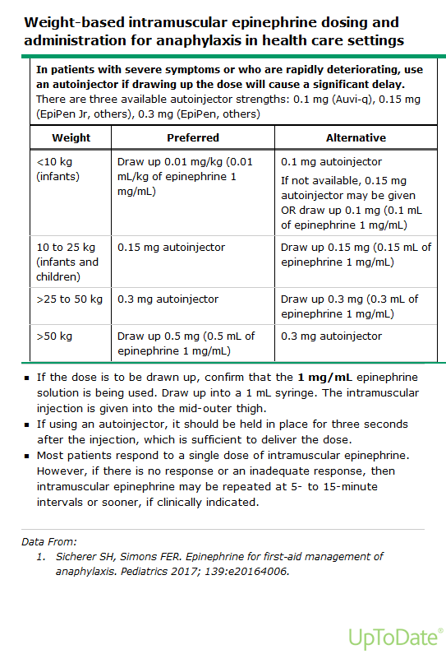

Slide 15
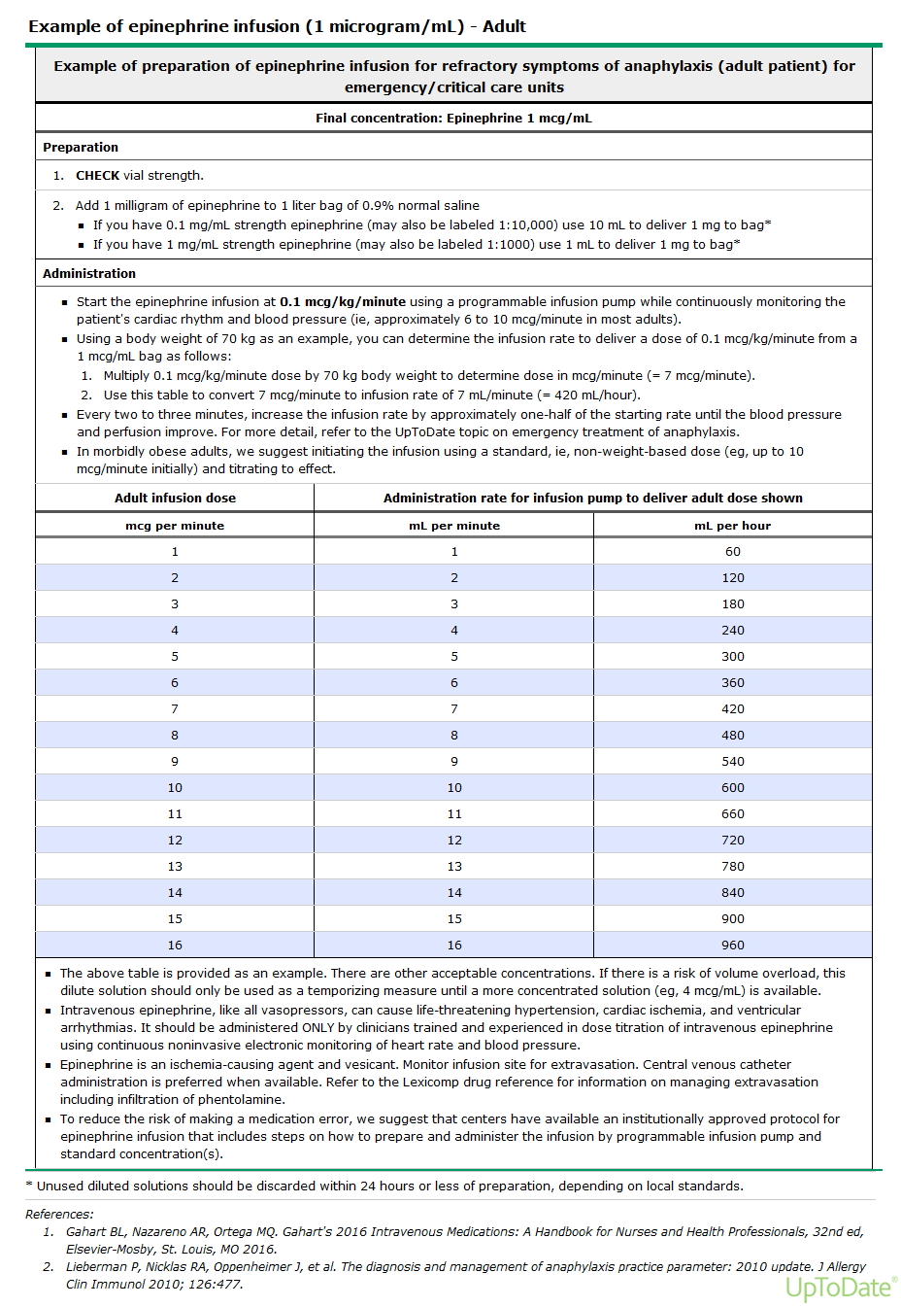

Slide 16
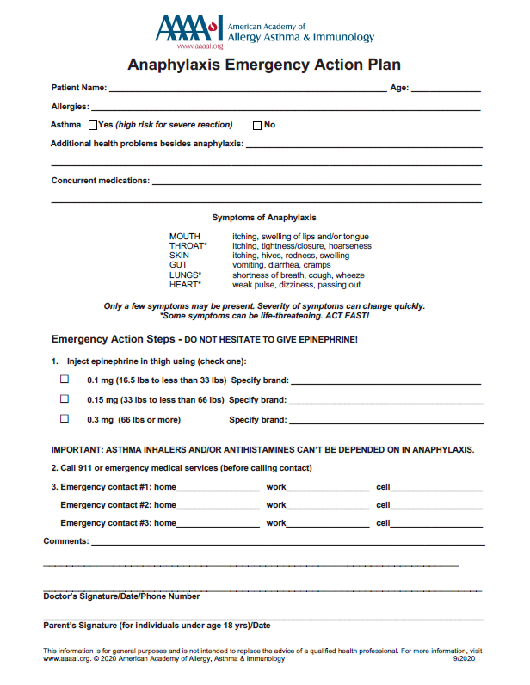

Slide 18
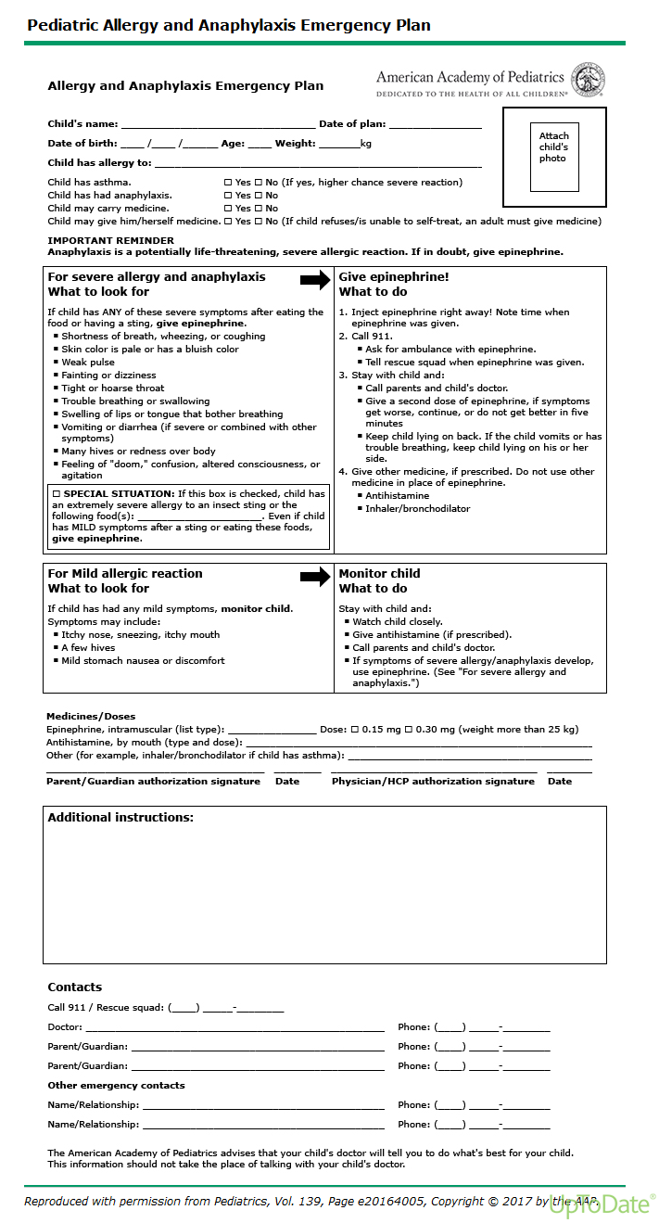

Slide 19
https://www.cochranelibrary.com/about/about-cochrane-reviews

Slide 20
Glucocorticoids for the treatment of anaphylaxis
Anaphylaxis is a serious allergic reaction that is rapid in onset and may result in death. It is commonly triggered by a food, insect sting, medication, or natural rubber latex. The reaction typically occurs without warning and can be a frightening experience both for those at risk and their families and friends. Steroids (glucocorticoids) are often recommended for use in the management of people experiencing anaphylaxis. However, the evidence base in support of the use of steroids is unclear. We therefore conducted a systematic review of the literature, searching key databases for high quality published and unpublished material on the use of steroids for the emergency treatment of anaphylaxis. In addition, we contacted experts in this health area and the relevant pharmaceutical companies. We were unable to find any randomized controlled trials on this subject through our searches. We conclude that there is no evidence from high quality studies for the use of steroids in the emergency management of anaphylaxis.
Therefore, we can neither support nor refute the use of these drugs for this purpose.

Slide 21
H1‐antihistamines for the emergency treatment of anaphylaxis
Anaphylaxis is a rare, but potentially life‐threatening emergency. Evidence from the United Kingdom suggests that incidence may be increasing rapidly. Common triggers of anaphylaxis include a variety of foods, drugs and insect venoms.
H1‐antihistamines are commonly used for the emergency treatment of anaphylaxis although the evidence underpinning this treatment is unclear. We therefore conducted a systematic review of the literature searching key databases for high quality published and unpublished material on this subject; in addition, we contacted experts in this area and relevant pharmaceutical companies.
Our searches failed to retrieve any randomized controlled trials on this subject. We conclude there is no evidence from randomized controlled trials to support the use of H1‐antihistamines in the emergency management of anaphylaxis.

Slide 22
Adrenaline auto‐injectors for the treatment of anaphylaxis in the community
Anaphylaxis is a serious allergic reaction that is rapid in onset and may cause death. It is commonly triggered by a food, insect sting, medication, or natural rubber latex. The reaction typically occurs without warning and can be a frightening and life‐threatening experience for those at risk and for their families and friends. Adrenaline (epinephrine) is widely advocated as the main treatment in people experiencing anaphylaxis and many people at risk of anaphylaxis are prescribed adrenaline auto‐injectors (such as the Adrenaclick, Anapen, Epipen, Jext, and Twinject) so that they or their families can, if needed, administer adrenaline in the community. Potential problems with adrenaline auto‐injector use include failure to carry the auto‐injector at all times; failure to use it because the signs and symptoms of anaphylaxis are not recognized; a preference to use an oral antihistamine; or fear and panic in the emergency. In addition, in many countries adrenaline auto‐injectors are either not available or they are not affordable. The evidence base regarding the effectiveness of adrenaline auto‐injectors is unclear. We therefore conducted a systematic review of the literature, searching key databases for high quality published and unpublished material on the use of adrenaline auto‐injectors during episodes of anaphylaxis in the community. We also contacted the relevant pharmaceutical companies to see if they had any such information on the topic. Our searches found many studies relating to anaphylaxis and adrenaline auto‐injector use but no randomized controlled trials on this subject. We concluded that the use of adrenaline auto‐injectors in anaphylaxis is based on the best available information at present.
There is no evidence from randomized controlled trials for the effectiveness of adrenaline auto‐injectors in the emergency treatment of anaphylaxis in the community.
Such trials would ideally involve comparison of adrenaline with placebo; however, use of a placebo in anaphylaxis treatment would be unethical.
We therefore recommend that auto‐injectors remain the medication of first choice in the treatment of anaphylaxis in the community.

Slide 23
Adrenaline for the emergency treatment of anaphylaxis
Anaphylaxis is a serious allergic reaction that is rapid in onset and may cause death. It is commonly triggered by a food, insect sting, medication, or natural rubber latex. The reaction occurs without warning and can be a frightening experience for those at risk and for their families and friends. Adrenaline (epinephrine) is widely advocated as the main treatment in those individuals experiencing anaphylaxis. There is no other medication with a similar effect on the many body systems that are potentially involved in anaphylaxis. The evidence base in support of the use of adrenaline is unclear. We therefore conducted a systematic review of the literature searching key databases for high quality published and unpublished material on the use of adrenaline for emergency treatment; in addition, we contacted experts in this area and the relevant pharmaceutical companies. Our searches retrieved no randomized controlled trials on this subject.
We concluded that the use of adrenaline in anaphylaxis is based on tradition and on evidence from fatality series in which most individuals dying from anaphylaxis had not received prompt adrenaline treatment.
Adrenaline appears to be life saving when injected promptly, however, there is no evidence from randomized controlled trials for or against the use of adrenaline in the emergency treatment of anaphylaxis.
Given the infrequency of anaphylaxis, its unpredictability and the speed of onset of reactions, conducting such trials is fraught with ethical and methodological difficulties.

Slide 24
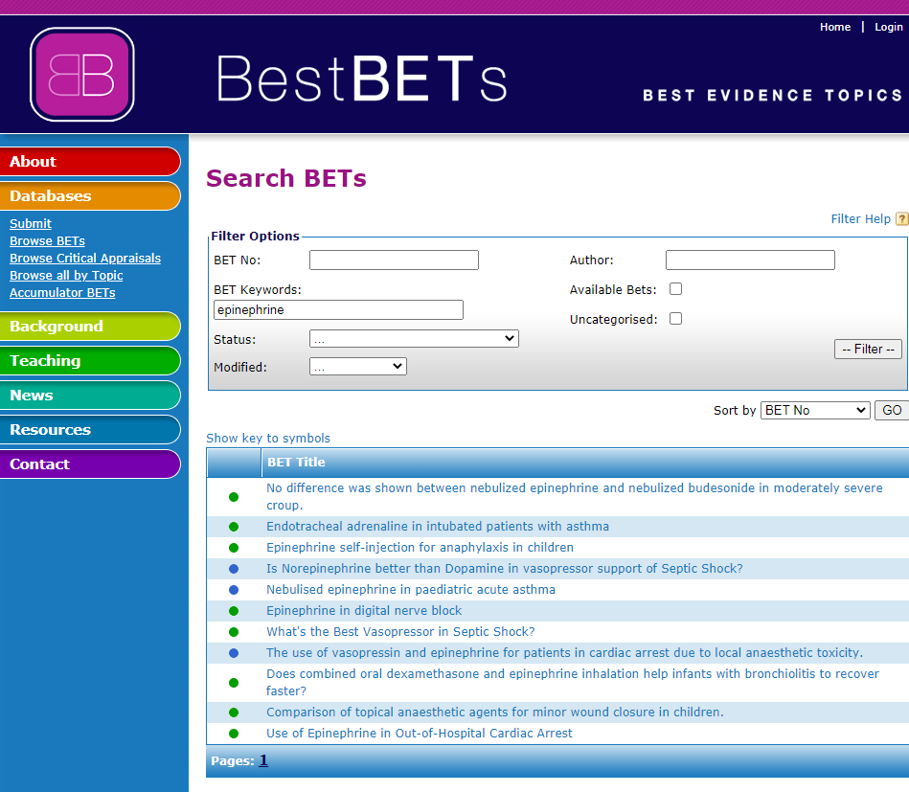

Slide 25
Epinephrine self-injection for anaphylaxis in children
2008
Three Part Question
In [children with anaphylaxis] does [self-injection of epinephrine] lead to [reduced mortality and morbidity]?
Search Outcome
Altogether 94 papers were identified using Medline, 585 using Embase and 26 using Cochrane. Three papers provided evidence that was relevant to the three-part question.
Clinical Bottom Line
Where available, epinephrine auto-injectors should be utilised in the community at an early stage for severe anaphylactic reactions, although high-quality evidence is lacking. To maximise any potential benefit it is important to provide education for patients, parents and carers regarding injection technique and ensuring auto-injector availability at all times.Level of Evidence
Level 3 - Small numbers of small studies or great heterogeneity or very different population.

Slide 26
H2 antagonists in anaphylaxis
2009
Three Part Question
In the [treatment of anaphylaxis] does the addition of an [H2 receptor antagonist] [improve outcome]?
Search Outcome
518 papers were identified.
Clinical Bottom Line
There is some evidence to support the use of H2 antagonists in anaphylaxis but the clinical significance of this is uncertain.

Slide 27
Nebulised salbutamol or nebulised adrenaline for wheeze in anaphylaxis
2009
Three Part Question
In [patients with anaphylaxis] is [nebulised salbutamol better than nebulised adrenaline] at [reducing wheeze]?
Search Outcome
36 papers were found but none answered the specific question
Clinical Bottom Line
Patients with severe (life-threatening) acute allergic reactions should be treated with intramuscular adrenaline according to the Resuscitation Council Guidelines (2008).

Slide 28
Intravenous or intramuscular adrenaline for anaphylaxis
2007
Three Part Question
In [patients with anaphylaxis] is [intramuscular adrenaline better than intravenous adrenaline] at [treating the anaphylaxis and avoiding toxicity]?
Search Outcome
164 papers found. 2 were relevant to the question. Cochrane review protocol and expert opinions are discussed in the comments section.
Clinical Bottom Line
Intramuscular injection is safer than intravenous adrenaline. Intramuscular adrenaline is recommended by the Resuscitation council of UK(2005).

Slide 29
To lie or not to lie – the best position for patients in anaphylaxis?
2013
Three Part Question
In [children in anaphylaxis] does [lying flat with feet elevated] help with [cardiovascular and respiratory symptoms]?
Search Outcome
158 papers were found, only one was relevant
Clinical Bottom Line
Although again more research is needed in this area, it seems sensible to opt for this simple maneourve for patients in anaphylactic shock.
“In 4 patients death occurred in seconds after a movement to a more upright position In 1 patient death occurred after moving from a chair to a bed. In 5 patients had been supported in an upright position despite unconsciousness and subsequently died.” Pumphrey, RSH 2003 UK

Slide 30
Biphasic Anaphylaxis in the Emergency Department
2019
Three Part Question
What is the [risk of a biphasic reaction] in [patients with acute anaphylaxis] who have been [successfully treated with resolution of symptoms].
Search Strategy
Medline 1966-08/19 using PubMed, Cochrane Library (2019), and Embase. [(exp anaphylaxis) AND (exp biphasic reaction)]. Limit to English language.
Search Outcome
38 studies were identified; two recent systematic reviews addressed the clinical question.
Comment(s)
Biphasic anaphylaxis is an anaphylactic episode followed by an asymptomatic period with return of anaphylactic symptoms in the absence of further exposure to the triggering antigen. The traditional recommended ED observation time is 4-6 h after complete resolution of symptoms for every anaphylaxis patient. However, there is limited data to identify predisposing factors to recurrent reactions, and more recent data suggests this clinical entity is rare (4%) and can occur at any time between 10 minutes to 6 days. Consider sending the ED patient home with injectable epinephrine (epi pen) and steroids after a 1-hour observation period.Clinical Bottom Line
Biphasic anaphylaxis is a rare clinical entity with low morbidity and mortality. A 1-hour observation period has been shown to achieve a 95.0% negative predictive value (NPV), with little added clinical benefit when extending the observation period.

Slide 31
“So.... is it anaphylaxis?,
Maybe it’s just a reaction?!,
Maybe it’s just an allergy?
Will I wait and see....?”

Slide 32
So...
☑ Skin/Lips?
☑ Rapid onset?
☑ Respiratory compromise?
☑ Reduced BP?
=
ANAPHYLAXIS
=
ADRENALINE

Slide 33
Severe Asthma
Is it?
Is it anaphylaxis?
If in doubt treat for anaphylaxis

